Slide 1
Letters Aa, Bb, Cc

Slide 2
The Hello Song
Hello! How are you?
Hello! How are you?
I’m fine, fine, fine.
I’m fine, fine, fine.
TD: T patiently teaches the Hello Song to S by singing line by line. After each line, T stops and lets S sing. Once the entire song is taught, T and S sing it completely two more times.

Slide 3
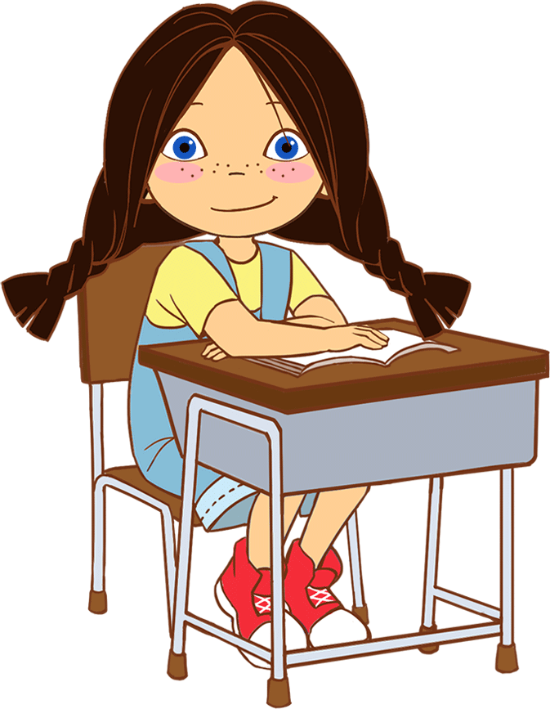
Whole Body Listening
Eyes are looking
TD: T teachers the first VIPKID classroom rule by emphasizes that S’s eyes should be looking at the teacher.

Slide 4
Say and Do
Clap your hands.
Touch your head.
Touch your ears.
Touch your nose.
Clap your hands.
Stand up.
Sit down.
High five.
TD: T reads the sentences to S, defining each sentence with the corresponding body movement. S does not need to repeat commands after T, only the movements.

Slide 5

Are you ready?
TD: T teaches S “Are you ready?” “Yes, I’m ready.” T and S practice multiple times.

Slide 6
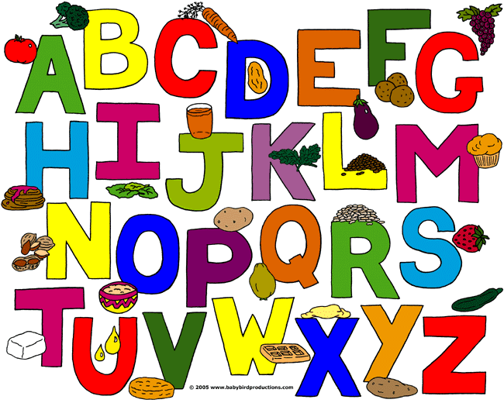
TD: T explains to S that this is the alphabet and today the focus of the class is letters A, B, and C. T does not go through the whole alphabet but focus on only the letter target for this class.

Slide 7
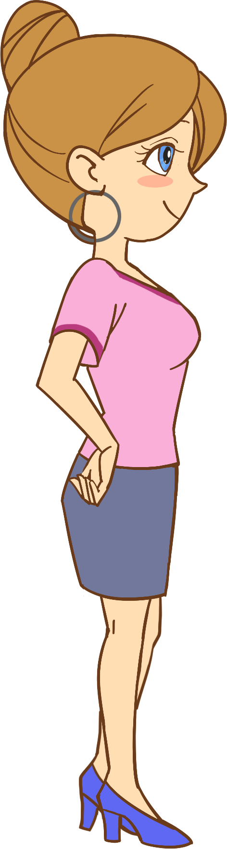
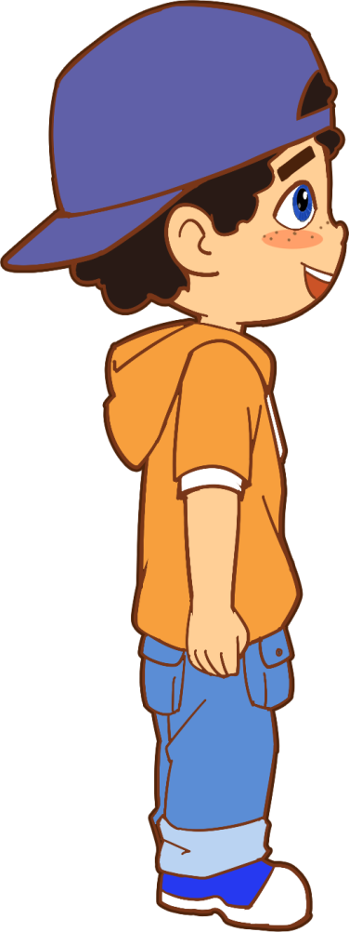
Hello.
Hello.
TD: T and S begin the conversation by saying hello to each other.

Slide 8
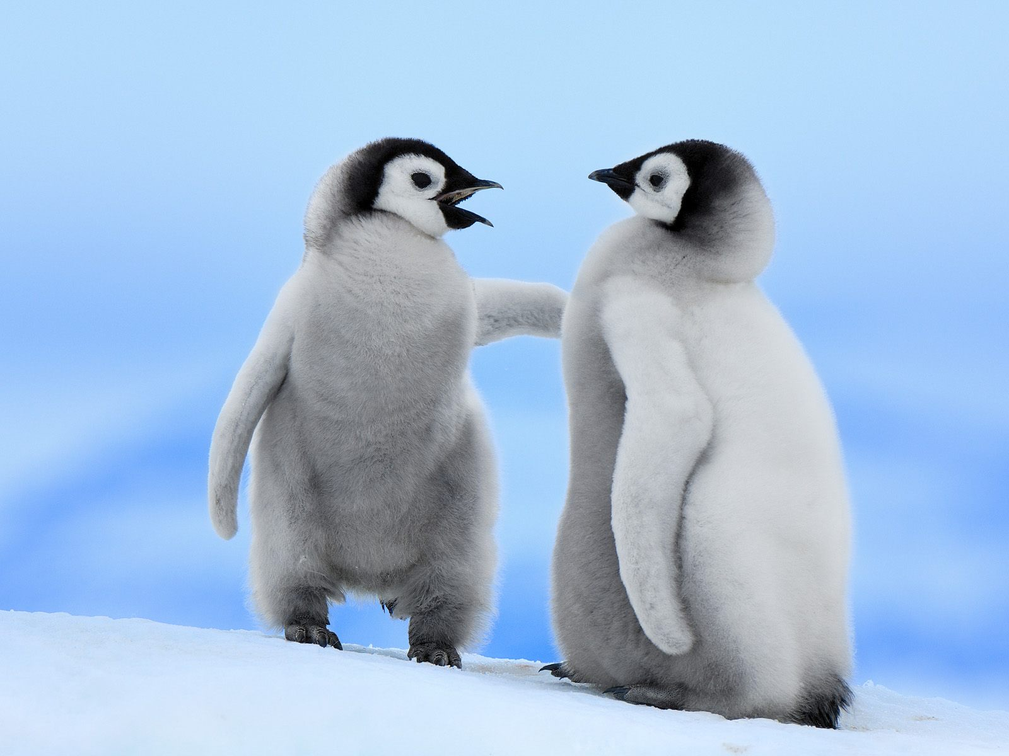
How are you?
TD: T and S continue the conversation. T: “How are you?” S repeats: “How are you?”

Slide 9
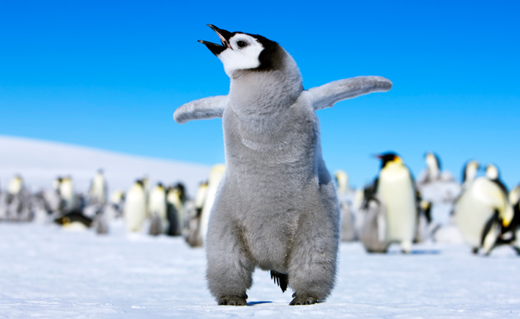
I’m fine, thanks!
TD: T and S continue the conversation. T: “I’m fine, thanks!” S repeats: “I’m fine, thanks!” After a couple of practices, flip between these 3 slides to practice the dialogue 3x from beginning to end.

Slide 10
Let’s Begin
Aa
TD: T teaches the letter name for big A and little a.

Slide 11
Bb
TD: T teaches the letter name for big B and little b.

Slide 12
Cc
TD: T teaches the letter name for big C and little c.

Slide 14

Circle
TD: T demonstrates how to circle by drawing a circle in the air and getting S to copy the motion. Then, T shows S the mouse and makes a circling motion in the air. Finally, T slowly draws a circle on these lines while saying “Circle”.

Slide 15
Circling Fun
c
a
b
a
b
b
c
TD: T demonstrates this entire activity. S can listen. If S understands, S can also circle the letter. But, if S doesn’t understand, they can just observe. T: “Circle a. Circle a.” T circles “a” while narrating what they are doing.

Slide 16





b
Start
1
2
3
a
4
c
7
6
5
FINISH
TD: T follows the arrows from 1-7, circling one letter at a time. As T circles, T says the name of the letter twice, and S repeats after T. Example: “b” “b” . Play again with T circling letter while prompting S to say letter name (use gestures like cupping hand over ear).

Slide 17
Hello.
Hello.
TD: T and S begin the conversation by saying hello to each other.

Slide 18
How are you?
TD: T and S continue the conversation. T: “How are you?” S repeats: “How are you?”

Slide 19
I’m fine, thanks!
TD: T and S continue the conversation. T: “I’m fine, thanks!” S repeats: “I’m fine, thanks!” After a couple of practices, flip between these 3 slides to practice the dialogue 3x from beginning to end.

Slide 20




Cool Down
Say and Do
Clap your hands.
Touch your head.
Touch your ears.
Touch your nose.
Clap your hands.
Stand up.
Sit down.
High five.
TD: 1. T and S complete the “Say and Do” activity together. 2. T then circles a letter and prompts S to say letter name (gestures).

Slide 21
Goodbye!
See you next time.
Goodbye!
See you next time.
Goodbye, bye, bye.
Goodbye, bye, bye.

